Slide 1
Logistic Regression

Slide 2
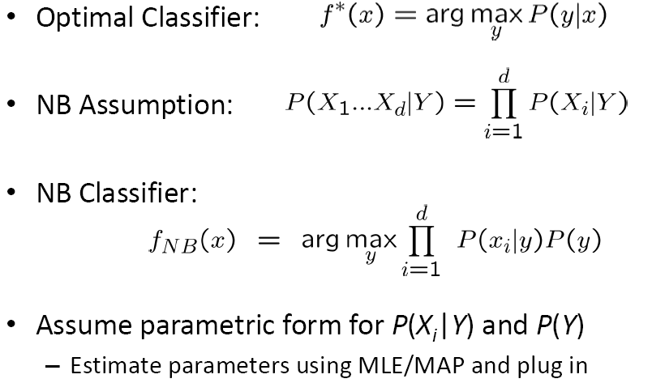
Naïve Bayes Review

Slide 3
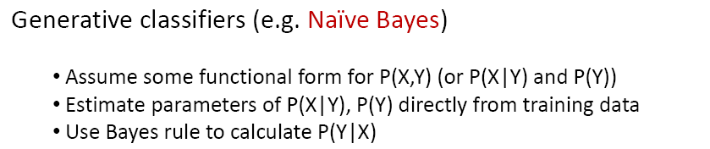
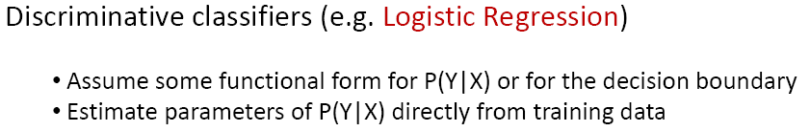
Generative vs. Discriminative Classifiers

Slide 4
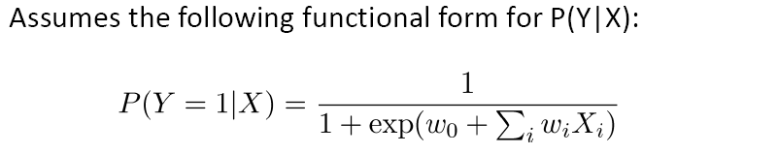
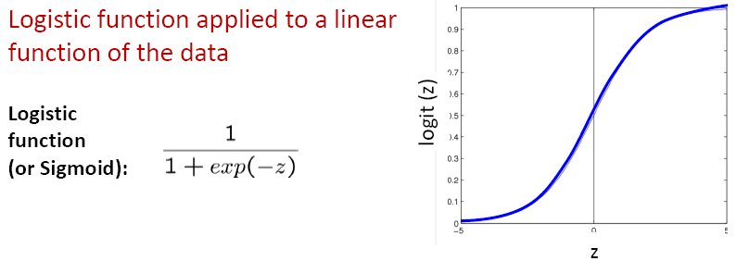
Logistic Regression

Slide 5
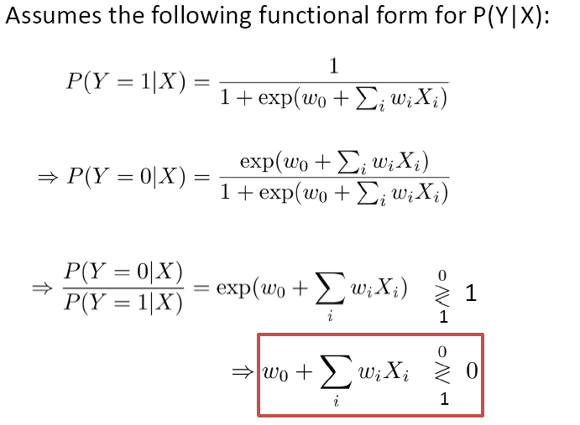
Is Logistic Regression a Linear Classifier?

Slide 6
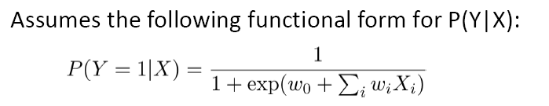
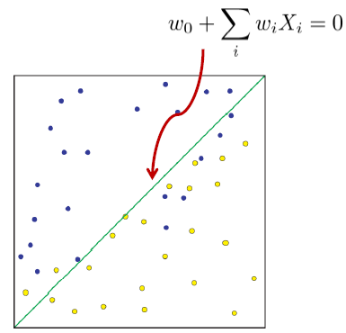
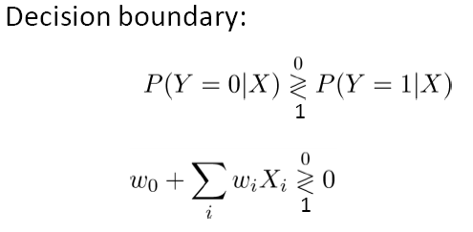

Logistic Regression is a Linear Classifier!

Slide 7
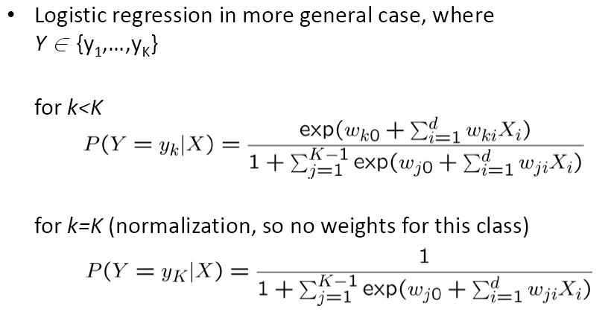
Logistic Regression for more than 2 classes

Slide 8
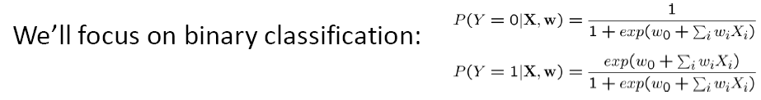
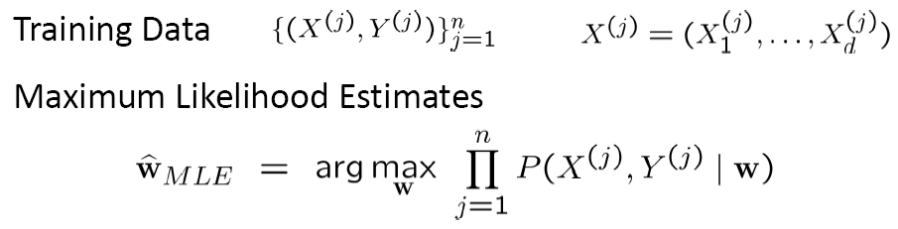
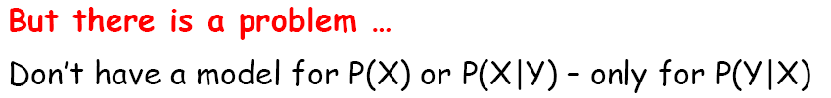
Training Logistic Regression

Slide 9
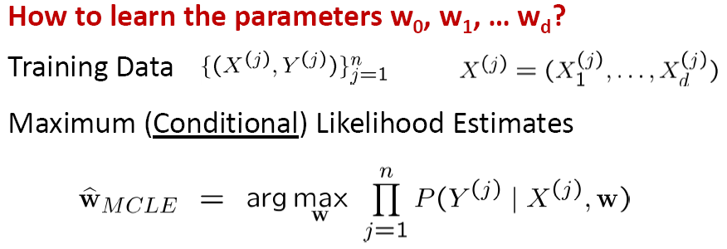
Training Logistic Regression

Slide 10
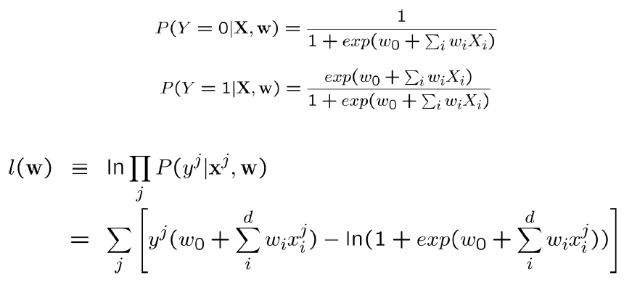
Expressing Conditional Log Likelihood

Slide 11
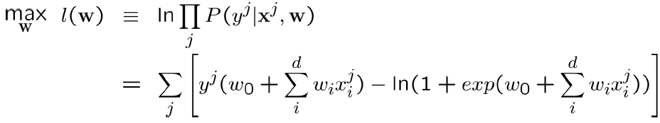

Maximizing Conditional Log Likelihood

Slide 12
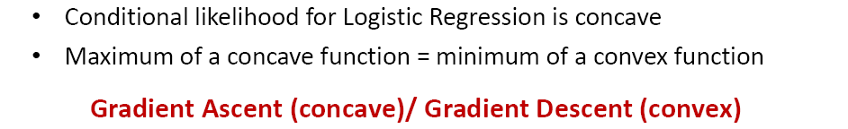
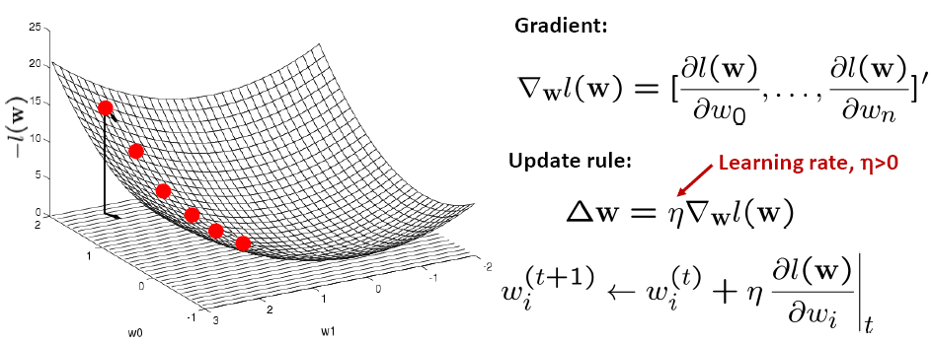
Optimizing concave/convex function

Slide 13
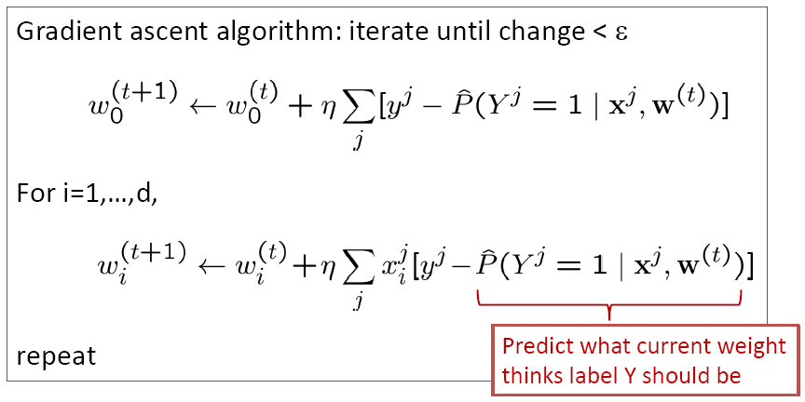
Gradient Ascent for Logistic Regression

Slide 14
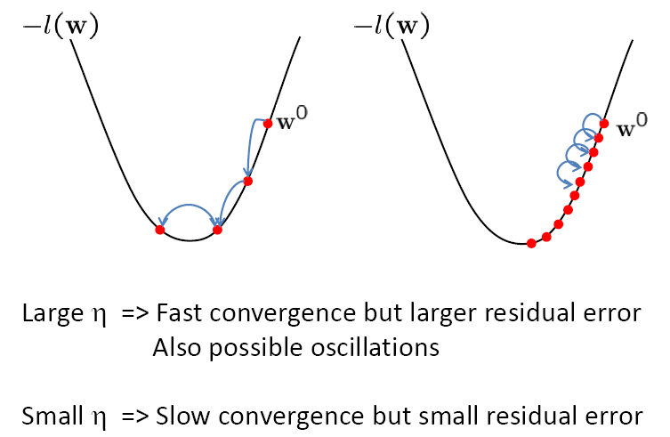
Effect of step-size η

Slide 15
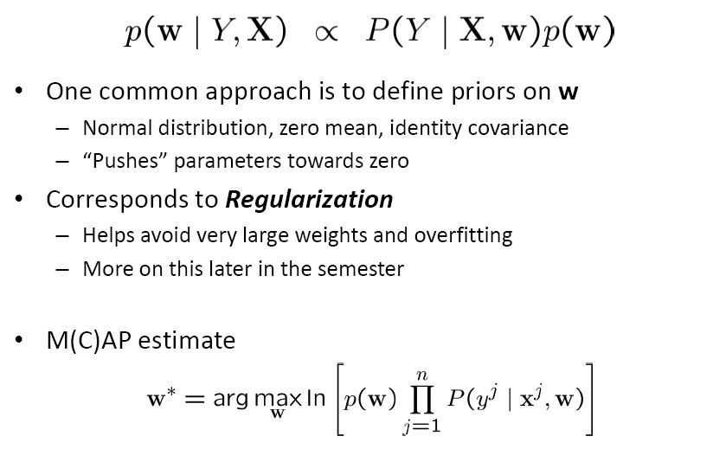
That’s all M(C)LE. How about MAP?

Slide 16
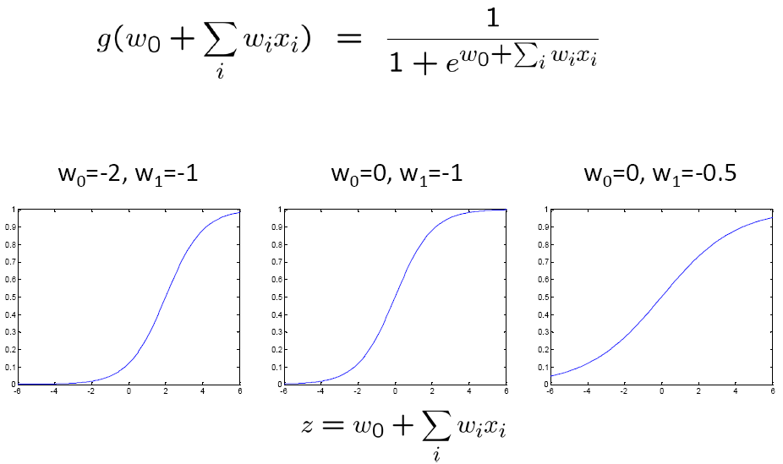
Understanding the sigmoid

Slide 17
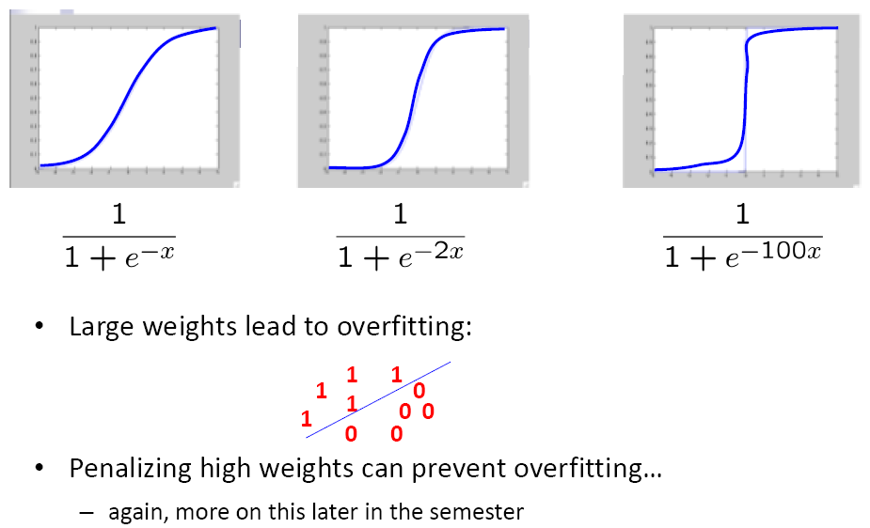
Large weights → Overfitting

Slide 18
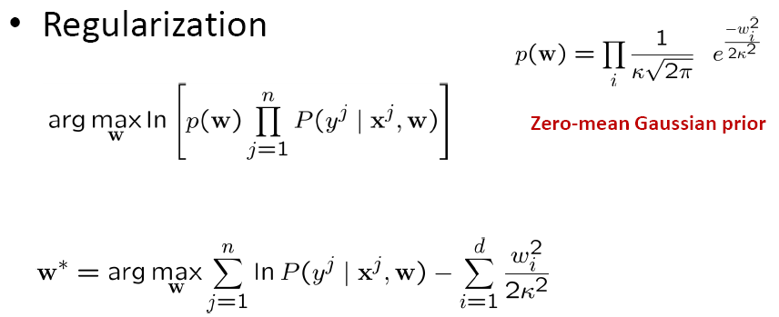

M(C)AP - Regularization

Slide 19
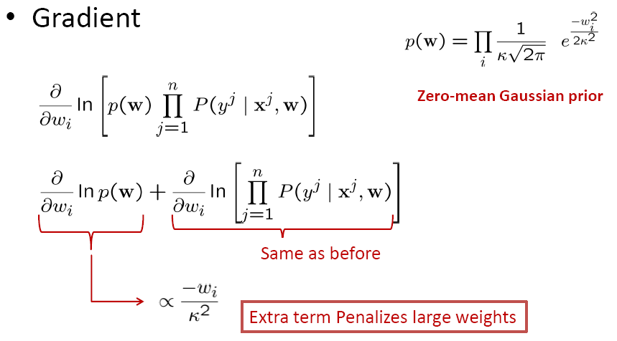
M(C)AP - Gradient

Slide 20
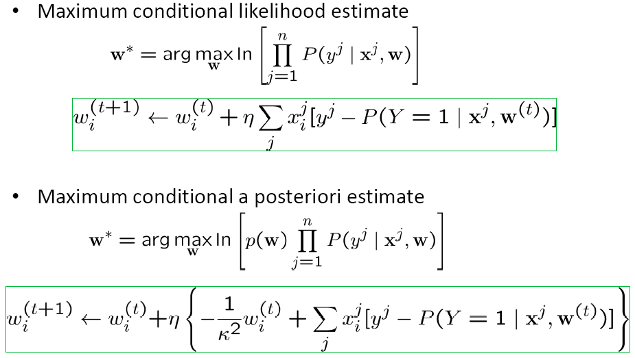
M(C)LE vs. M(C)AP

Slide 21
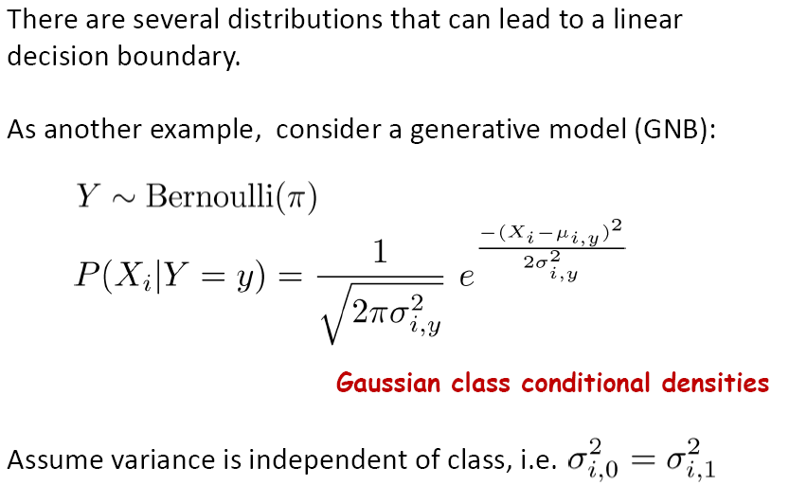
Connection to Gaussian Naïve Bayes

Slide 22
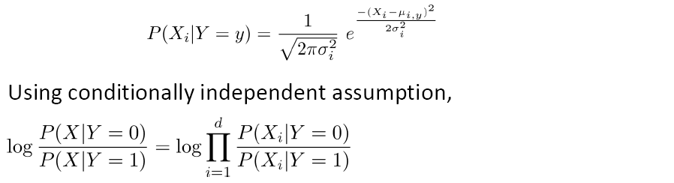
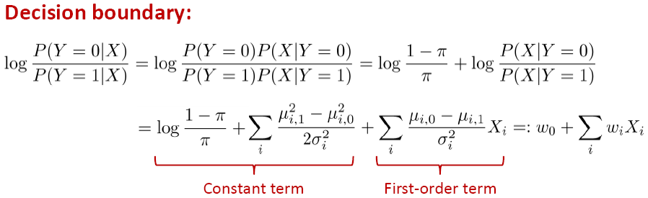
Connection to Gaussian Naïve Bayes

Slide 23
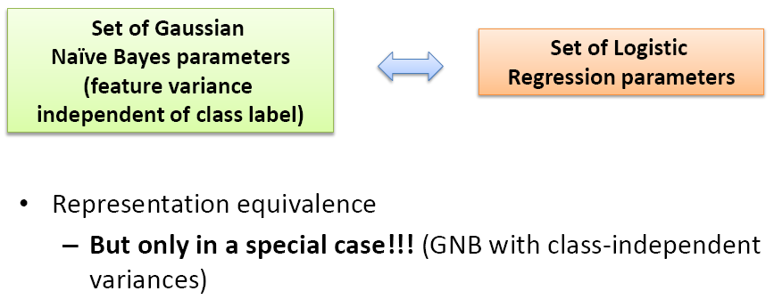
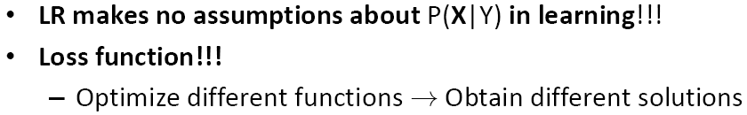
Gaussian Naïve Bayes vs. Logistic Regression

Slide 24
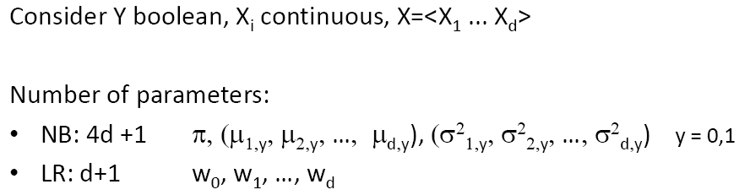
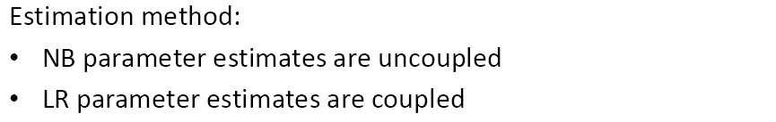
Naïve Bayes vs. Logistic Regression

Slide 25
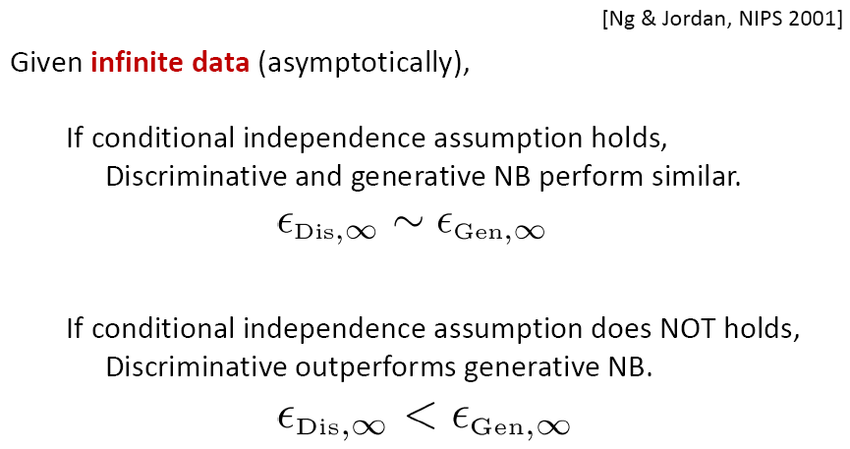
Generative vs. Discriminative

Slide 26
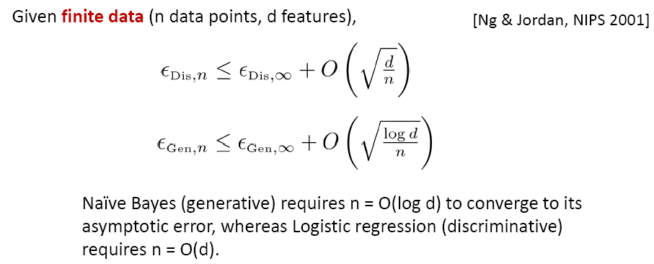

Generative vs. Discriminative

Slide 27
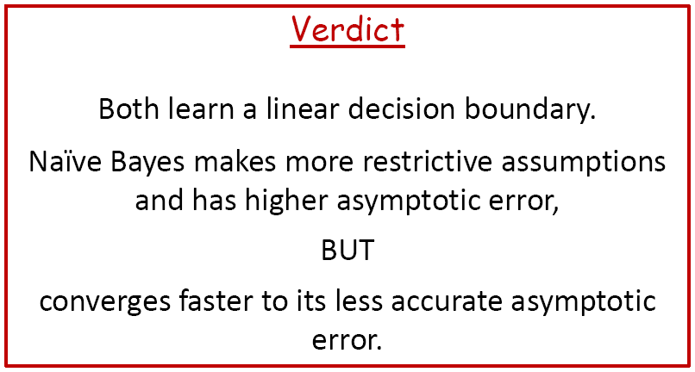
Naïve Bayes vs. Logistic Regression

Slide 28
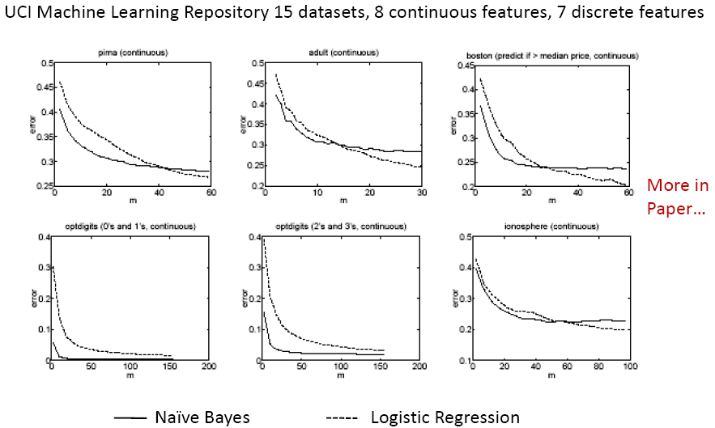
Experimental Comparison (Ng-Jordan’01)

Slide 29
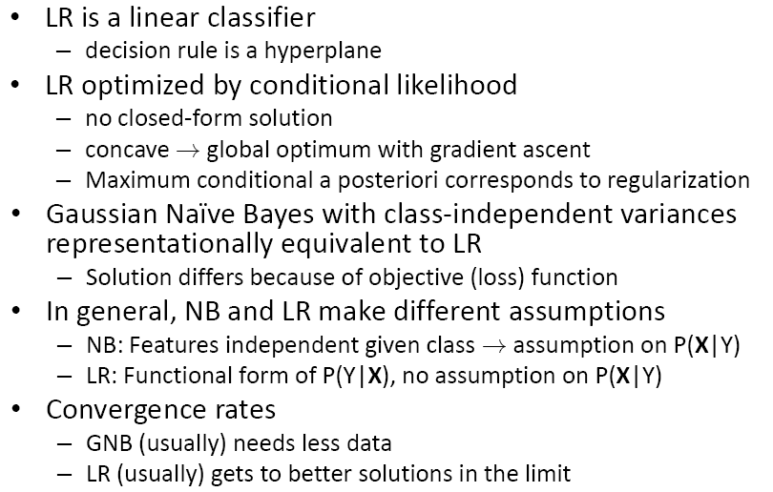
What you should know

